Slide 1

Driven Project Management
A Comprehensive Overview of Project Phases, Insights, and Outcomes
Project By
Dharmendra Kumar

Slide 2
Project Overview
Problem Statement
Key Deliverables
Dataset Overview
Tools and Techniques
Project Workflow
Data Acquisition Phase
Data Wrangling Phase
Data Analysis Phase
Final Submission Components
Key Insights and Observations
Learning Outcomes
Table of contents

Slide 3
Project Overview
Project
Objective of the Project: To resolve ambiguities and inconsistencies in multiple datasets, creating a clean, unified dataset for business analysis and modeling.
Key Deliverables: A well-integrated dataset prepared through systematic data wrangling. Insightful analysis ready for downstream applications, including trends and relationships derived from the data.
Datasets Utilized: Three datasets: Dataset_1, Dataset_2, and Dataset_3, sourced from Google Sheets for comprehensive analysis.
Phases of the Project: Phase 1: Data Preparation, including handling missing values and basic statistical analysis. Phase 2: Dataset Integration, focusing on merging datasets and outlier detection. Phase 3: Advanced Data Analysis, utilizing techniques such as skewness analysis and correlation computation.

Slide 4
Problem Statement
Data Integration Challenges Advanced Data-Wrangling Techniques
Addressing ambiguities and inconsistencies across multiple datasets to create a unified dataset for analysis.
Applying systematic methods to effectively merge datasets and handle missing values and outliers for accurate business insights.

Slide 5

Key Deliverables
Integrated Dataset
Insightful Analysis
Key Deliverables Integrated Dataset A comprehensive dataset combining Dataset_1, Dataset_2, and Dataset_3 Ensuring all missing values and outliers are appropriately handled
A detailed summary of data wrangling processes
Highlighting key observations, trends, and relationships derived from the dataset
Documentation and Presentation
A Jupyter Notebook containing all code, visualizations, and explanations
A PowerPoint presentation summarizing project objectives and findings

Slide 6
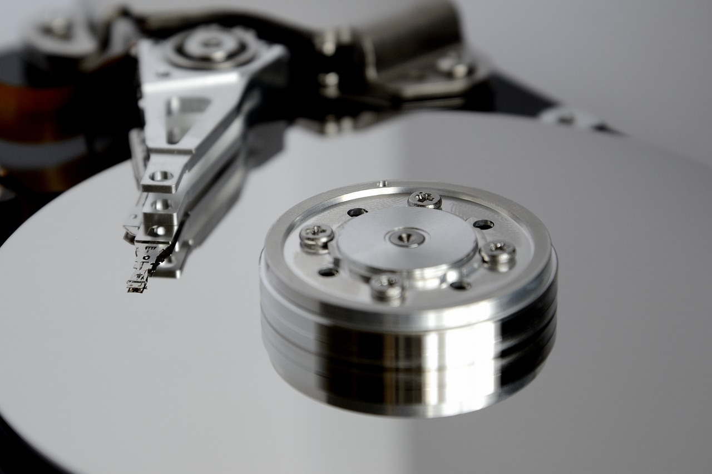
Dataset Overview
Datasets Utilized
Key Attributes
Dataset_1: Contains attributes related to user rentals and weather conditions.
Dataset_2: Provides additional user rental data for comprehensive analysis.
Dataset_3: Integrates with the other datasets to enhance insights.
Date: Represents the date of the ride.
Season: Coded as 1 (spring), 2 (summer), 3 (fall), 4 (winter).
User Rentals: Includes casual and registered rentals, with total counts for analysis.

Slide 7

Tools and Techniques
Data Manipulation
Numerical Computations
Application of NumPy for performing complex mathematical operations on datasets.
Utilization of Pandas for efficient data handling and transformation.
Data Integration and Cleaning
Merging multiple datasets using common keys and addressing missing values through imputation techniques.

Slide 8
Project Workflow
1
2
3
4
5
Data Acquisition
Load datasets into Python and inspect data structures to assess quality and completeness.
Data Wrangling
Integrate multiple datasets using common keys, ensuring consistency and resolving any ambiguities.
Handling Missing Values
Apply appropriate imputation techniques to address gaps in the data, enhancing dataset integrity.
Outlier Detection
Conduct detailed analysis to identify and manage outliers, ensuring accurate data representation.
Final Analysis
Perform advanced statistical analysis, including correlation computations and visualizations, to derive meaningful insights.

Slide 9
Data Acquisition Phase
1
Load Datasets
Begin by downloading and loading the three datasets (Dataset_1, Dataset_2, and Dataset_3) from Google Sheets into the analysis environment.
Inspect Data Structures
Utilize functions such as info() and head() to examine the data structures, ensuring a clear understanding of the attributes and data types present in each dataset.
Document Initial Observations
Record initial observations regarding data quality and completeness, identifying any potential issues that may need to be addressed in subsequent phases.
1
2
3

Slide 10




Data Wrangling Phase
Load Datasets
Inspect Data Quality
Begin by downloading and loading Dataset_1, Dataset_2, and Dataset_3 into the analysis environment for inspection.
Utilize methods such as `.info()` and `.head()` to evaluate the structure and completeness of the datasets, documenting any initial observations.
Data Wrangling
Handle Missing Values
Merge Datasets
Apply appropriate imputation techniques to address any missing values identified during the inspection phase, ensuring data integrity.
Integrate Dataset_1 and Dataset_2 using common keys, followed by concatenating Dataset_3 to create a unified dataset ready for analysis.

Slide 11
Data Analysis Phase
1
Data Preparation
Begin by handling missing values through imputation techniques and performing basic statistical analysis to evaluate central tendencies such as mean, median, and mode.
Data Integration
Next, concatenate the datasets, ensuring a thorough analysis of missing values and outlier detection, applying statistical methods to manage any identified outliers.
Advanced Data Analysis
Finally, analyze the skewness of numerical columns, compute correlations between attributes, and visualize key insights using heatmaps, scatter plots, and boxplots to derive meaningful conclusions.
1
2
3

Slide 12
Final Submission Components
Merged Dataset
Insights and Observations
A fully integrated dataset combining Dataset_1, Dataset_2, and Dataset_3, with missing values and outliers appropriately handled.
A comprehensive summary detailing the data wrangling and cleaning processes, along with key observations regarding trends, distributions, and relationships.
Jupyter Notebook
PowerPoint Presentation
A complete documentation of data acquisition, loading, wrangling, merging, and cleaning processes, including code and visualizations.
A concise presentation summarizing the project overview, objectives, data cleaning steps, challenges faced, and insights derived from the analysis.

Slide 13
Key Insights and Observations
Unified Dataset Creation
Advanced Data-Wrangling Techniques
Exploratory Data Analysis
Successfully integrated multiple datasets to produce a clean and unified dataset for analysis.
Applied systematic data-wrangling methods to resolve ambiguities and inconsistencies across datasets.
Conducted thorough exploratory data analysis, revealing significant trends and relationships within the data.
Visualization of Insights
Practical Experience Gained
Utilized various visualizations, including heatmaps and scatter plots, to effectively communicate findings.
Enhanced skills in dataset cleaning, wrangling, and preparation for advanced modeling and business applications.

Slide 14

Learning Outcomes
Practical Experience in Data Handling
Exploratory Data Analysis Techniques
Gain hands-on skills in dataset cleaning and wrangling techniques.
Develop proficiency in managing missing values and outliers.
Understand and apply various statistical methods for data analysis.
Utilize visualizations such as boxplots and heatmaps to derive insights.
Preparation for Advanced Modelling
Learn to prepare datasets for subsequent modeling and business applications.
Enhance ability to communicate findings effectively through presentations and documentation.

Slide 15
Thanks for watching

